Slide 1


Amazon Product Sentiment Analysis
Presented By:
Anshul Raj
Ashutosh Chauhan
Goutham
Sezhiyan SR
1

Slide 2
Introduction :
Amazon was founded in 1994 by Jeff Bezos and started as an online bookstore. Amazon has since grown to become the largest online retailer in the world.
Online shoppers depend heavily on product reviews for informed purchasing decisions due to the absence of in-person product experiences in the e-commerce retail industry.
2

Slide 3
Objective :
Analyze customer reviews to identify retention strategies, cluster customers based on sentiment, and use trend and seasonality analysis to predict future shopping frequency.
The goal is to create a system that can automatically analyze and monitor a large volume of reviews.
To enhance the effectiveness of current and upcoming products and marketing strategies.
3

Slide 4
Data Description
COLUMNS | DESCRIPTION
ASIN | PRODUCT ID
REVIEWTEXT | REVIEWS
REVIEWERNAME | REVIEWER NAME
OVERALL | RATING
UNIXREVIEWTIME | REVIEW TIME
REVIEWTIME | REVIEW DATE
USERID | REVIEWER ID
TITLE | PRODUCT NAME
CATEGORIES | SUB CATEGORIES
PRICE | PRICE OF PRODUCT
BRAND | BRAND OF PRODUCT
4

Slide 5
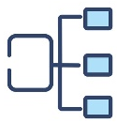

Roadmap of Data Analysis
Preprocessing and Cleaning
Time Series Analysis
Text Classification
Exploratory Data Analysis
Machine Learning
Algorithms
Business Interpretation
5

Slide 6

Exploratory Data Analysis
6
Notes:
Drag & drop to add a picture in the placeholder

Slide 7
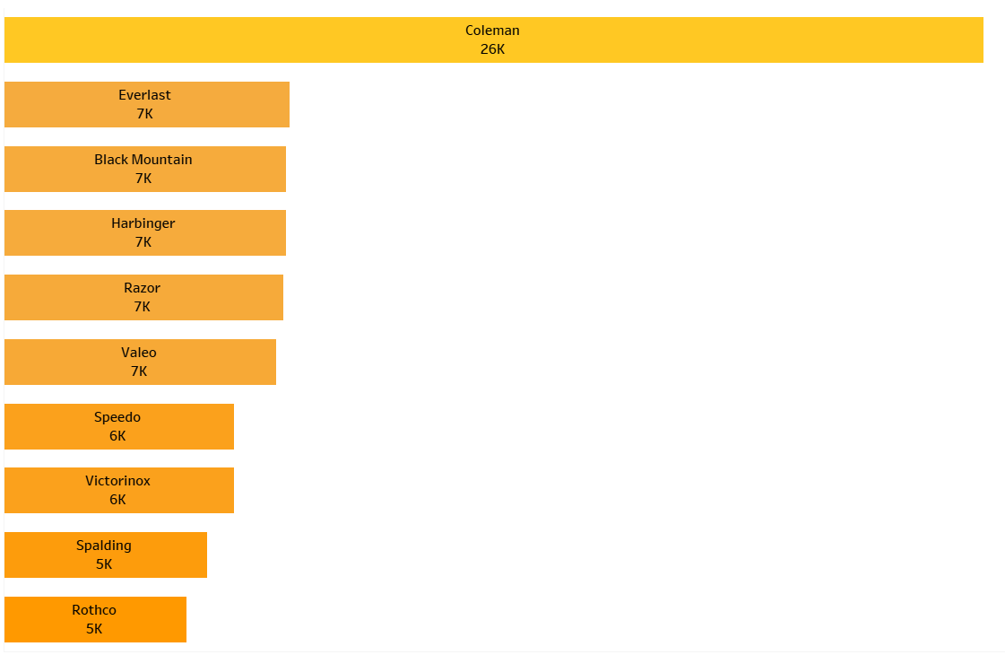
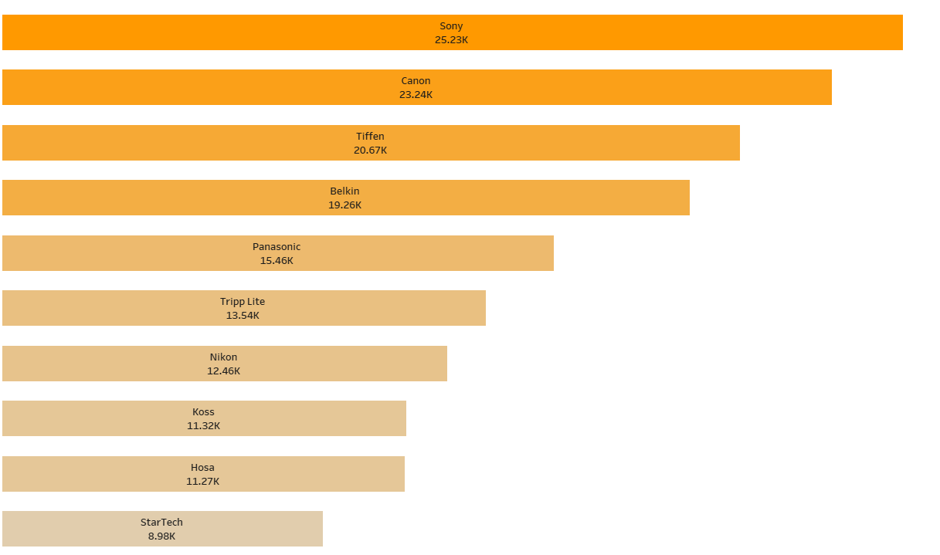
Most Reviewed Brands
Brand
Brand
Count of Reviews
Count of Reviews
Sports and outdoors
Electronics
7

Slide 8
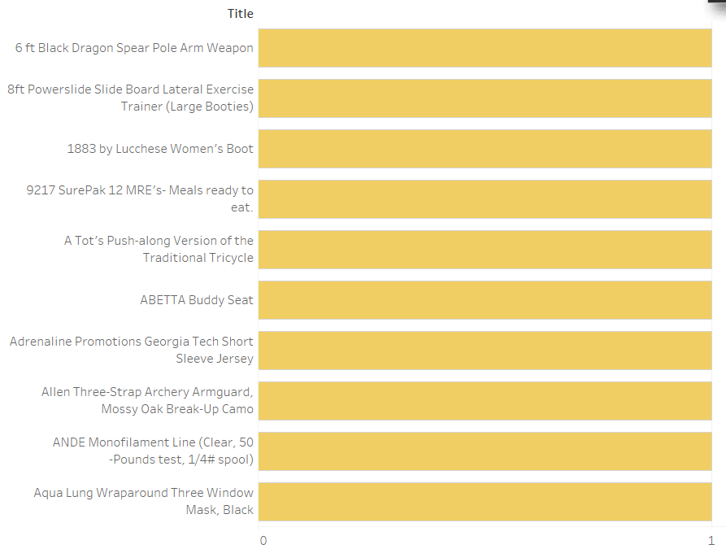
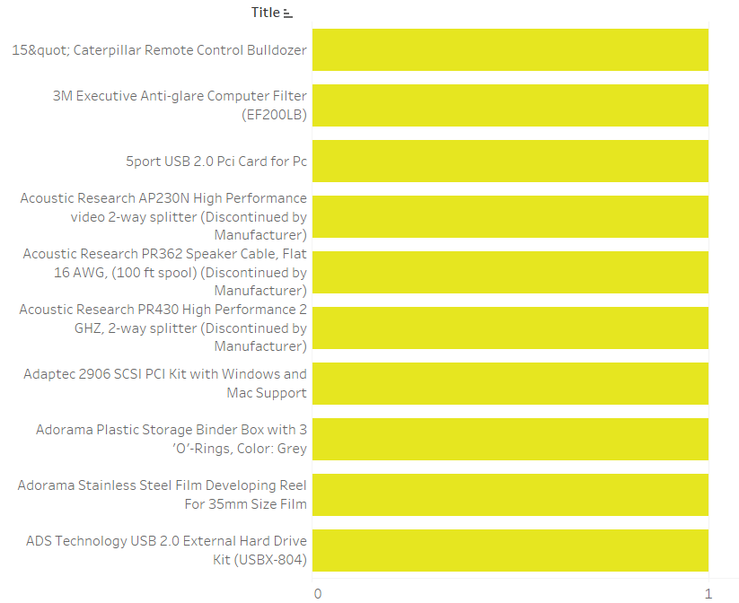
Least Reviewed Products
Products
Products
Count of Reviews
Count of Reviews
Sports and outdoors
Electronics
8

Slide 9
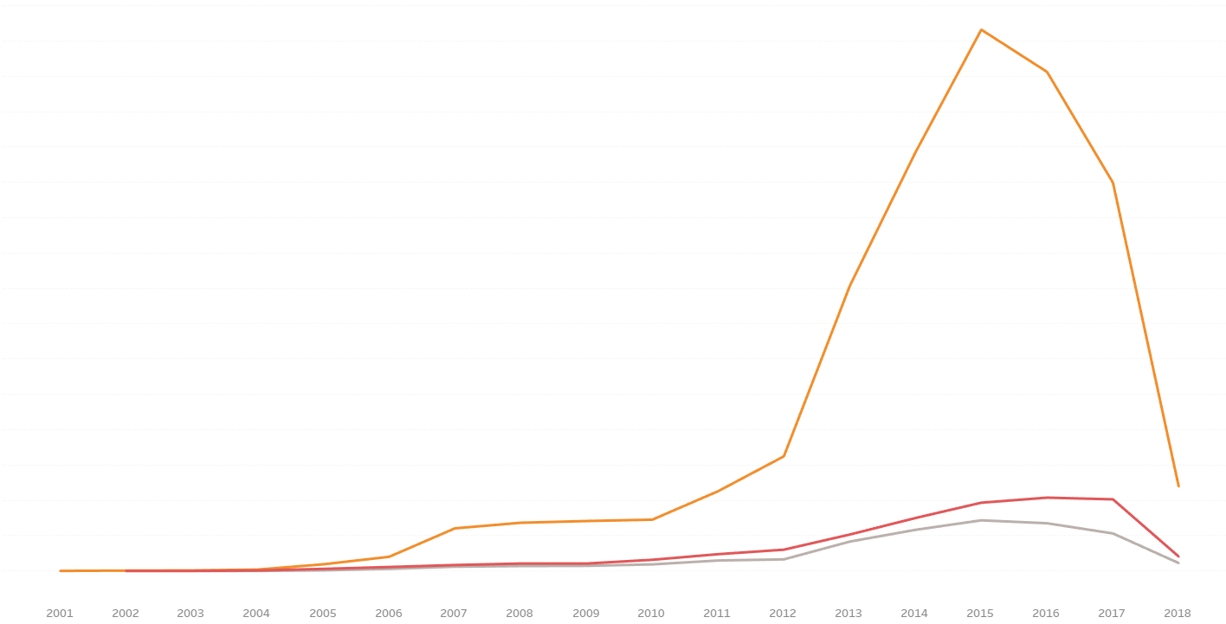
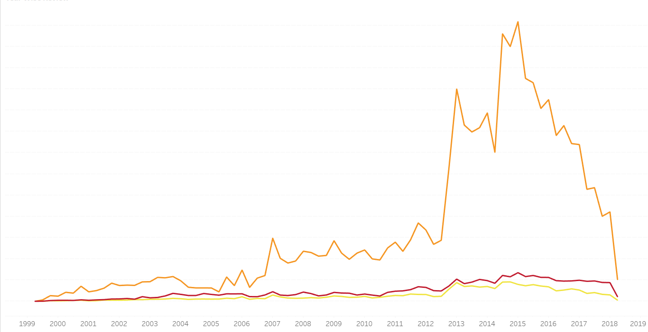
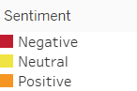
Year Wise Reviews
67.7 K
47.9 K
Count of Reviews
Count of Reviews
8.33 K
6.6 K
Year
Year
Sports and outdoors
Electronics
9

Slide 10
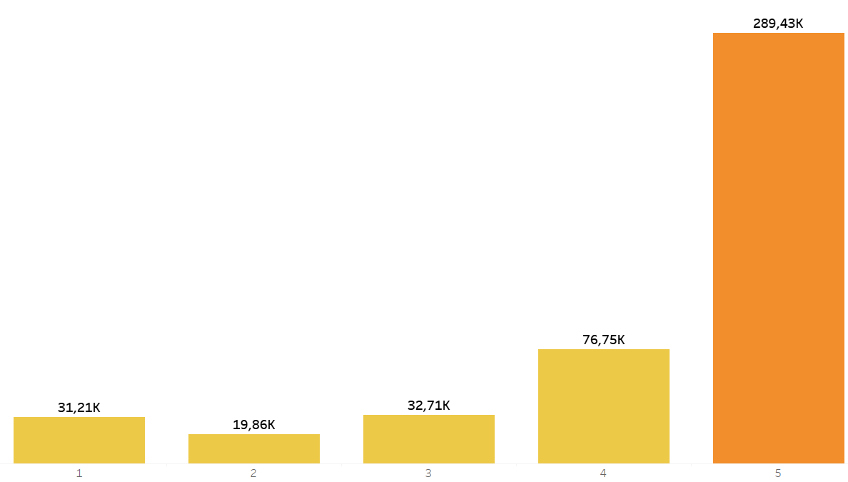
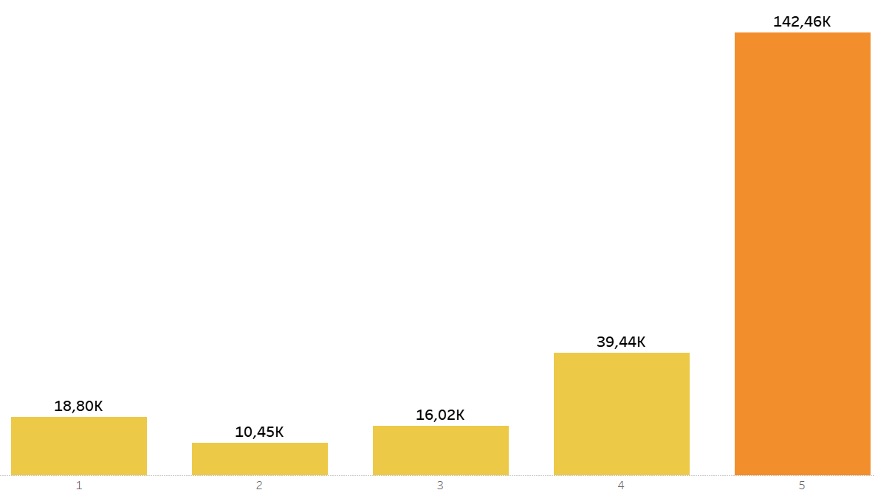
Rating Wise Count Of Reviews
Reviews
Reviews
Ratings
Ratings
Sports and outdoors
Electronics
10

Slide 11
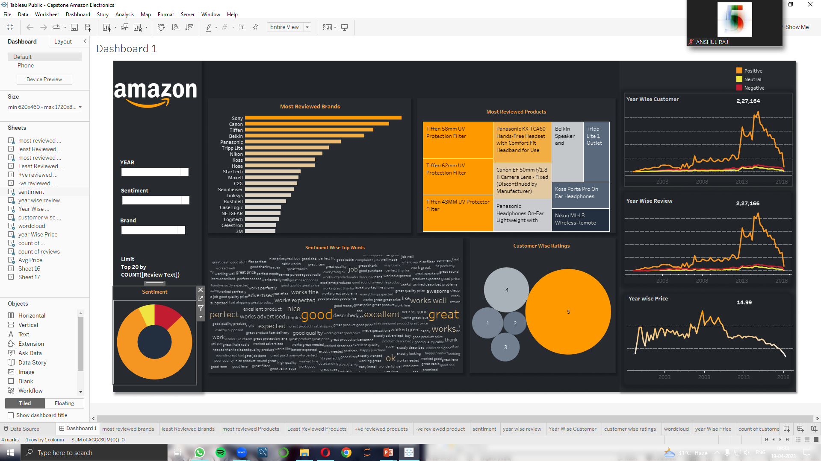
Professional Dashboard
Category: Electronics
11

Slide 12
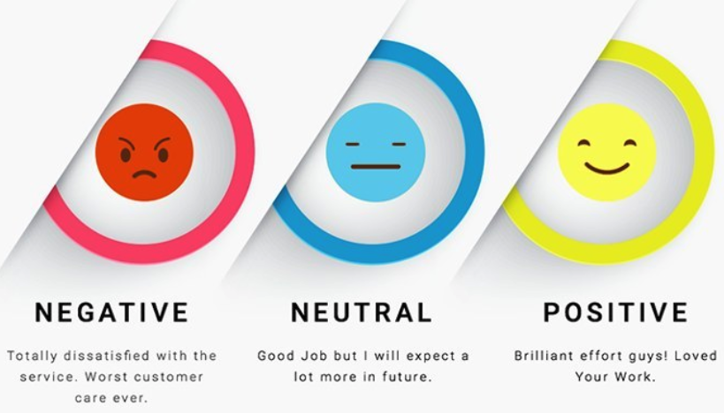
SENTIMENT ANALYSIS USING NLP
Sentiment Analysis is a common tool for text classification that detects the sentiment of a message as positive, negative, or neutral.
VADER is a sentiment analysis tool used to analyze social media text that incorporates informal language and expressions.
TFIDF is a method for converting text into a numerical format.
12
Notes:
Drag & drop to add a picture in the back placeholder

Slide 13
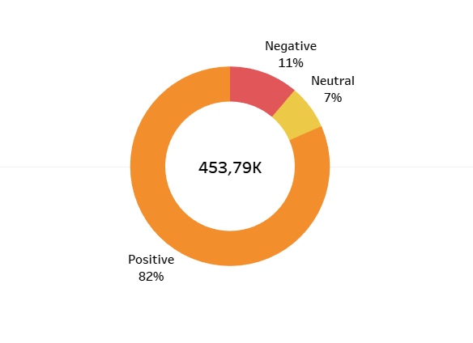
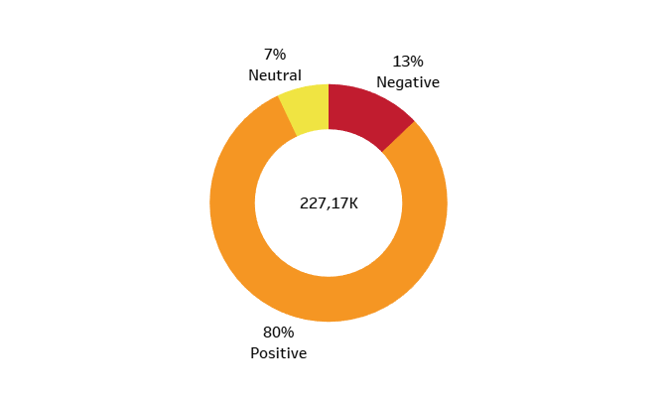
Sentiment Wise Composition Of Reviews
Sports and outdoors
Electronics
13

Slide 14
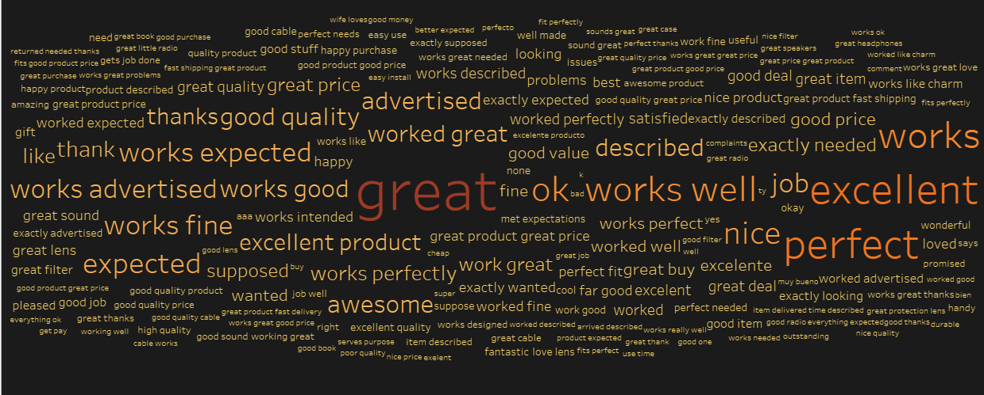
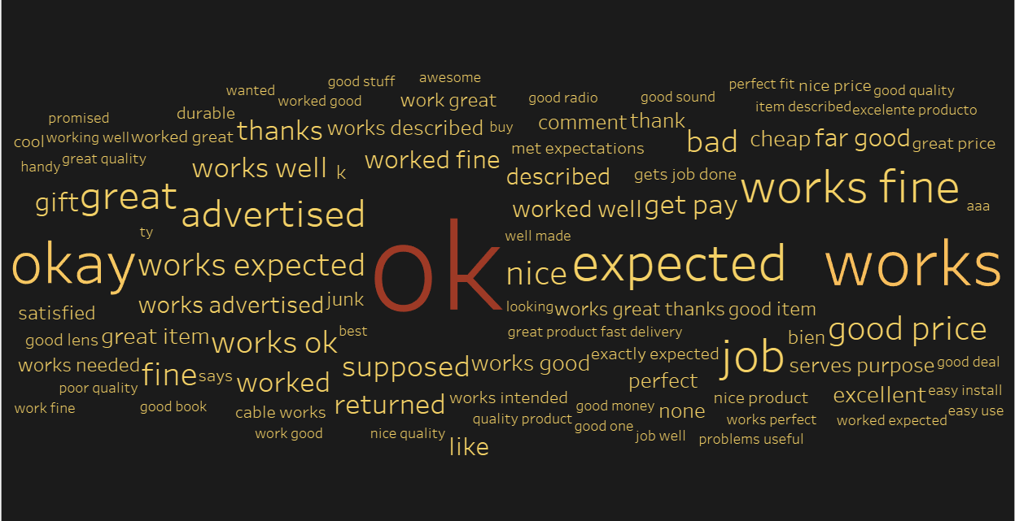
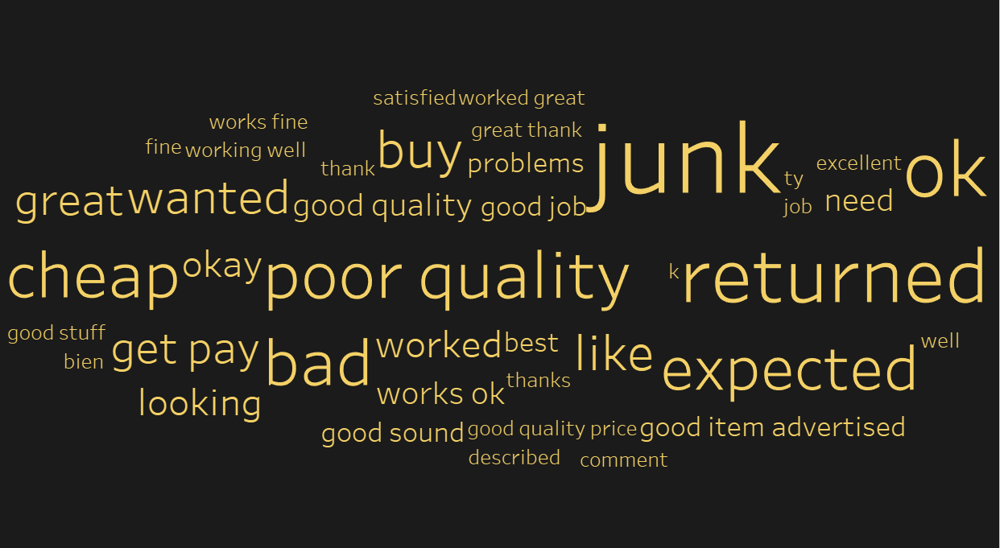
Wordcloud
Purpose of Wordcloud:
To display the most prominent and frequent words in all the three different sentiments.
14
Notes:
Drag & drop to add a picture in each placeholder

Slide 15
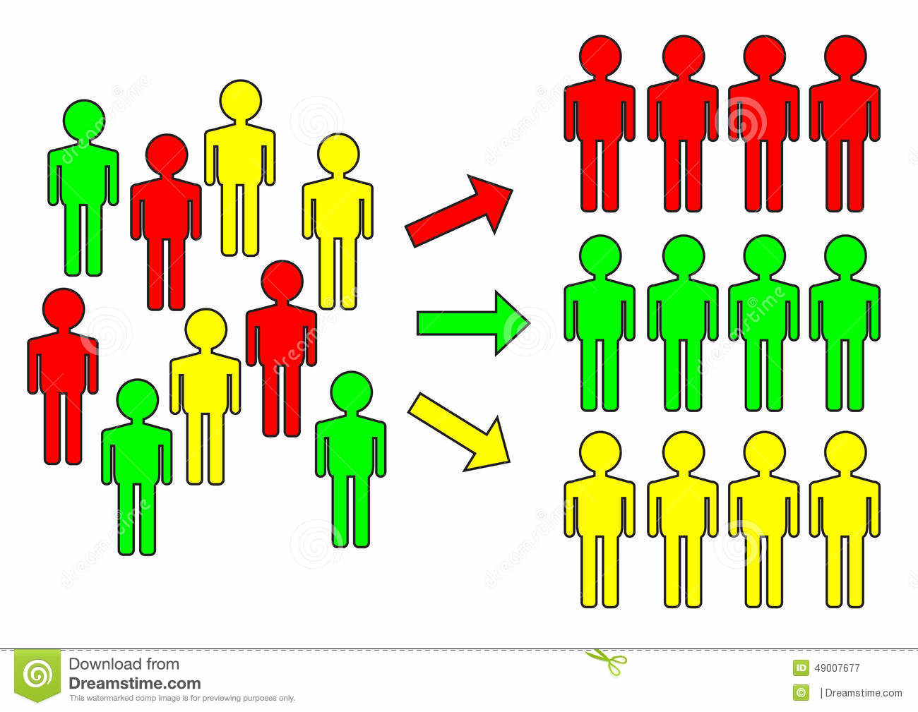
Customer Classification
Classification of the customer to understand who would most likely to purchase product in future.
Using TFIDF (Term Frequency Inverse Document Frequency) for converting text into numbers.
Classification models used: Logistic Regression, Decision Tree, Random forest , KNN.
Best performing models: Logistic Regression , Random Forest.
15

Slide 16
Customer Classification
MODELS | ACCURACY SCORE
LOGISTIC REGRESSION | 89%
NAVIE BAYAS | 82%
DECISION TREE CLASSIFIER | 84%
RANDOM TREE CLASSIFIER | 83%
Sports And Outdoors
15

Slide 17
Customer Classification
MODELS | ACCURACY SCORE
LOGISTIC REGRESSION | 87%
NAVIE BAYAS | 80%
DECISION TREE CLASSIFIER | 79%
RANDOM TREE CLASSIFIER | 77%
Electronics
15

Slide 18
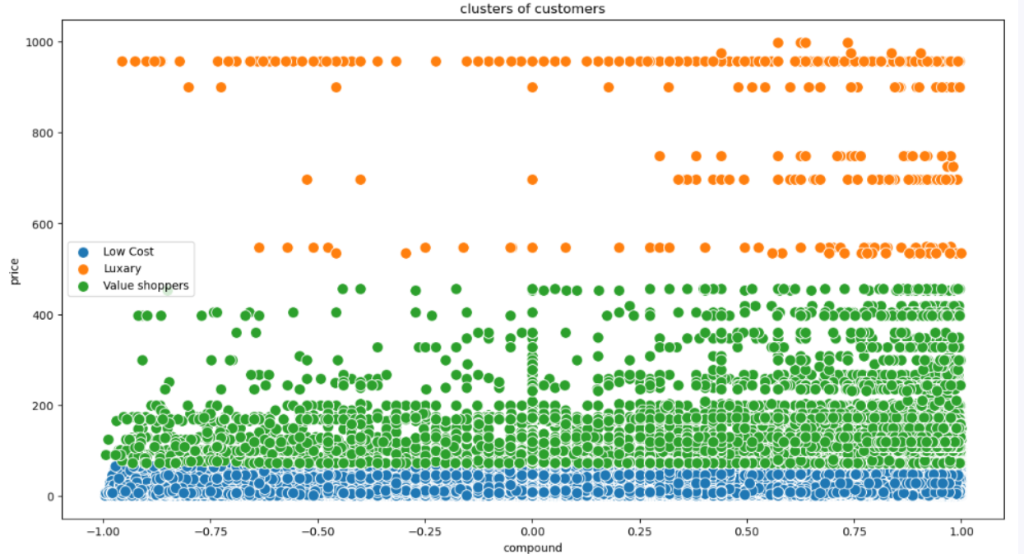
Clustering:K-Means
Most popular and fastest clustering algorithm.
Forms different clusters of equal variance in which resulting clusters are convex.
It is based on centroids.
Parameter: computes the optimal number of clusters(K)
16

Slide 19
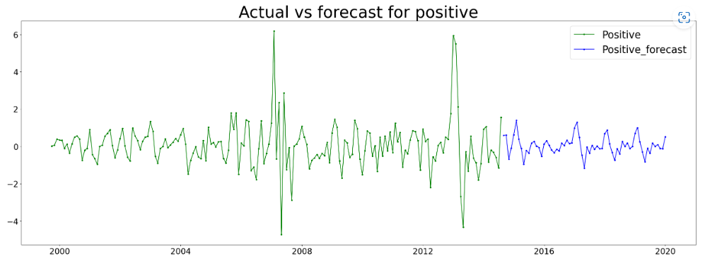
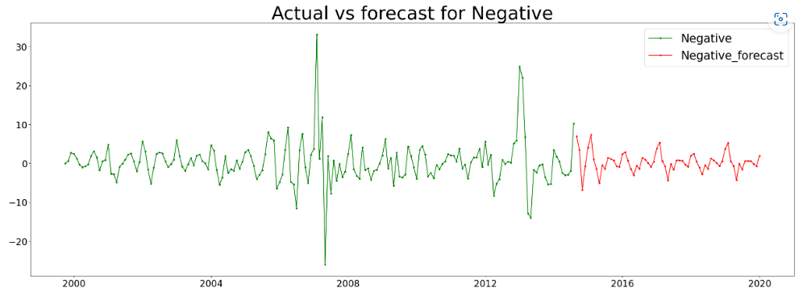
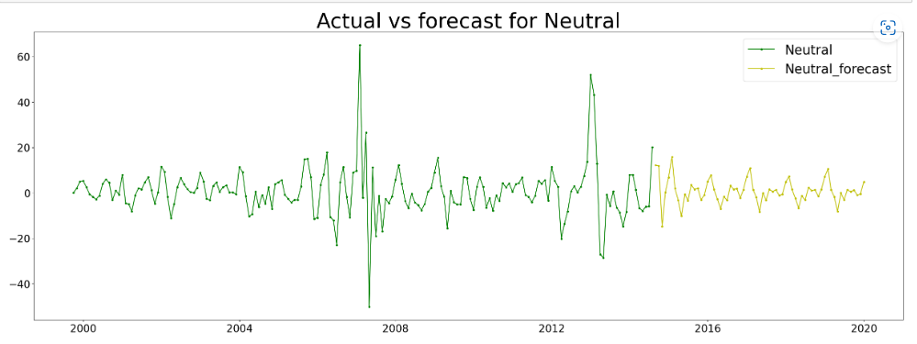
Time Series Analysis
positive
negative
Review time
Review time
Electronics
Brand: Sony
neutral
Review time
17

Slide 20
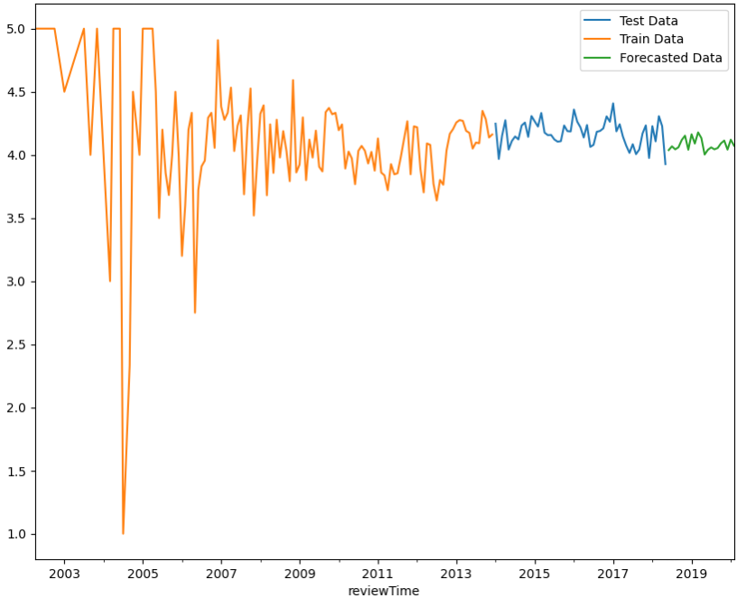
Time Series Analysis
Ratings
Sports and outdoors Brand: Coleman
18

Slide 21
Business Interpretation
By analysing all the factors of the customer reviews of the given data Sports and Outdoors and Electronics Category of Amazon data Top Brand Of Electronics Category: Sony Is the Top brand in sports and outdoor category and most positively, negatively and Neutrally Reviewed product belongs to this category. By Analysing the products of brand Sony, we say that the brand is very popular among all the customers and the product stocks of this brand have to be surplus in future. If we provide surplus products of Sony brand in our website the flow customers would be more but the highest selling products are digital Speakers, Cameras. We have to bit more focused on the mentioned products.
19

Slide 22
Business Interpretation
By analysing all the factors of the customer reviews of the given data Sports and Outdoors and Electronics Category of Amazon data Top Brand Of Sports and Outdoors: Coleman Is the Top brand in sports and outdoor category and most positively, negatively and Neutrally Reviewed product belongs to this category. By Analysing the products of brand Coleman, we can say that the brand is very popular among all the customers and the product stocks of this brand have to be surplus in future. If we can provide surplus products of Coleman brand in our website the flow of customers would be more for the specific prices which are 2.72 $, 5.13 $, 12.97 $, 14.69 $, 136.52 $.
20

Slide 23
thanks!

